Slide 1
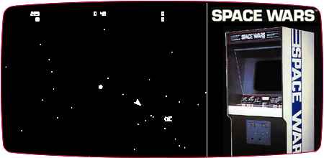
Modular of Aspects
Final Project,
SpaceWars AOP
Aviv Kotek, Raz Warman

Slide 2
We will:
Use Java code with AspectJ for implementing Aspects.
Use Normal aspects syntax AND @AspectJ annotations style – practice annotations (more readable, “new” java style).
Implement our own annotations as pointCuts.
Add functionality to the game.
Logg, audit and control game behavior.
Analyze game behavior… and more!

Slide 3
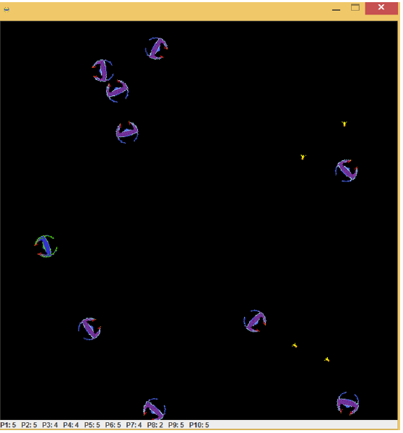
Base class: SpaceWars
Space Wars is a 1977 vector graphics arcade game based on the 1962PDP-1 program Spacewar!.
We will use the version written by us in OOP course.

Slide 4
Base class design
COMPLETE MAIN DESIGN OF SYSTEM….

Slide 5
Our main Aspects:
Spectative aspects:
Game Logging Aspect – saves data about game (time took, num of shots, start of game, etc..)
Audit Aspect - logs game events using method signature, for auditing (security) and data analysis.
Regulative Aspects:
Lock aspect: locks some feature of the player - for e.g: can’t shoot anymore.
UI update aspect: each time some value is change (e.g: asteroid is hit) - we display it on screen.
Invasive Aspects:
Heuristic aspect: changes heuristic of the game (change from drunk player to smart player).
Asteroids creator aspect: creates objects each time we have annotation of @AsteroidEntity
ExceptionHandler Aspect – Monitors exceptions and handles unhandled exceptions.

Slide 6
In details

Slide 7
Spectative Aspects

Slide 8
Spectative Aspects:
Instead of scattering the use of logger object (logger.log(type, msg)) in all of our program, we use an aspect to control logging.
Game Logging
Aspect
Audit
Aspect

Slide 9
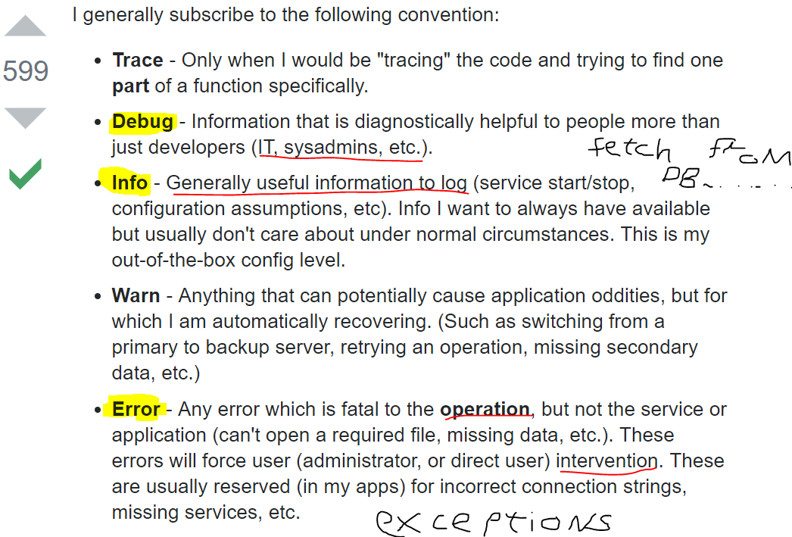
Log4j2
Apache license (open source) software, since 2001.
Most common logging framework in the java world.
Logging levels:
DEBUG, INFO, ERROR
Configure by.xml – separated from app
Can change logging level on RUNTIME!!
We logged in a synchronous way

Slide 10
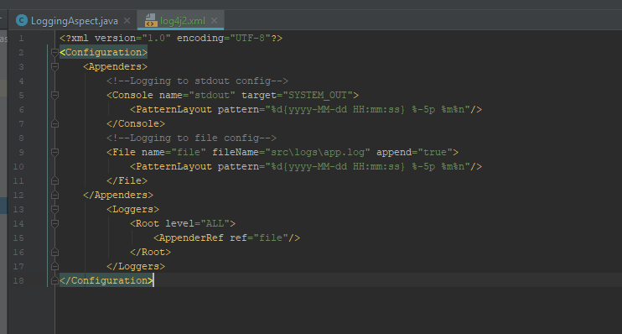
Log4j2 config file

Slide 11
Game Logging Aspect:
Instead of scattering the use of logger object (logger.log(type, msg)) in all of our program, we use an aspect to control logging.
Pointcut:
Game analysis - total time game took, total shoots made, total collisions.
Main game events – use custom annotation - @Loggable annotation to use in methods that do not conform with wildcard pattern. Log them to file and print to STDOUT to inform player.
Advice: Log code into logs/app.log file depends on annotation in runtime.

Slide 12
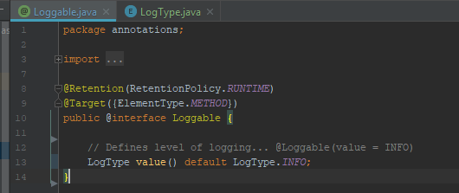
@Loggable
Custom made annotation
Programmer marks method with @Loggable annotation AND it typeLevel!
Retention: Source/Runtime – not-visible/visible by the compiler.
Target: Method – use this annot only on methods.

Slide 13
Audit Aspect:
Logs (audits) data to file, for later analysis and security. (in real application we would like to log this to RDBMS).
Pointcut:
Set/get operations (after).
Do (interface) operations (after).
Advice: Log code into logs/app.log file depends on annotation in runtime.

Slide 14
Regulative Aspects

Slide 15
Invasive Aspects

Slide 16
Invasive Aspects:
Instead of…
ExceptionHandler Aspect

Slide 17
ExceptionHandlerAspect

Slide 18
Testing the aspects

Slide 19
Testing our aspects – unit testing aspects?
Logging Aspect – just by checking the written files. If have time <write uni test to check file>

Slide 20
TODO
Test aspects
Comments of aspects classes ONLY
Log events to database????

